Slide 1
CVI General Resources
Contracting
CVI General Resources LLC is a minority owned consulting and contracting firm.
Our business model allows us to formulate strategic business partnerships bring expertise
together to pursue and manage business opportunities.
Utilizing our unique commercial and government relationships we have created a pool of resources to problem solve and get the job done.
We have built a consortium of companies we partner with in order to formulate strategies to bid and win business.

Slide 2
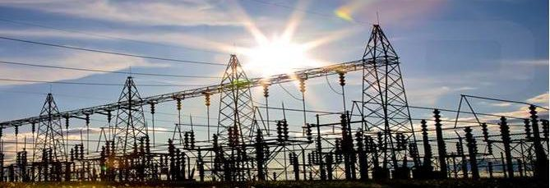
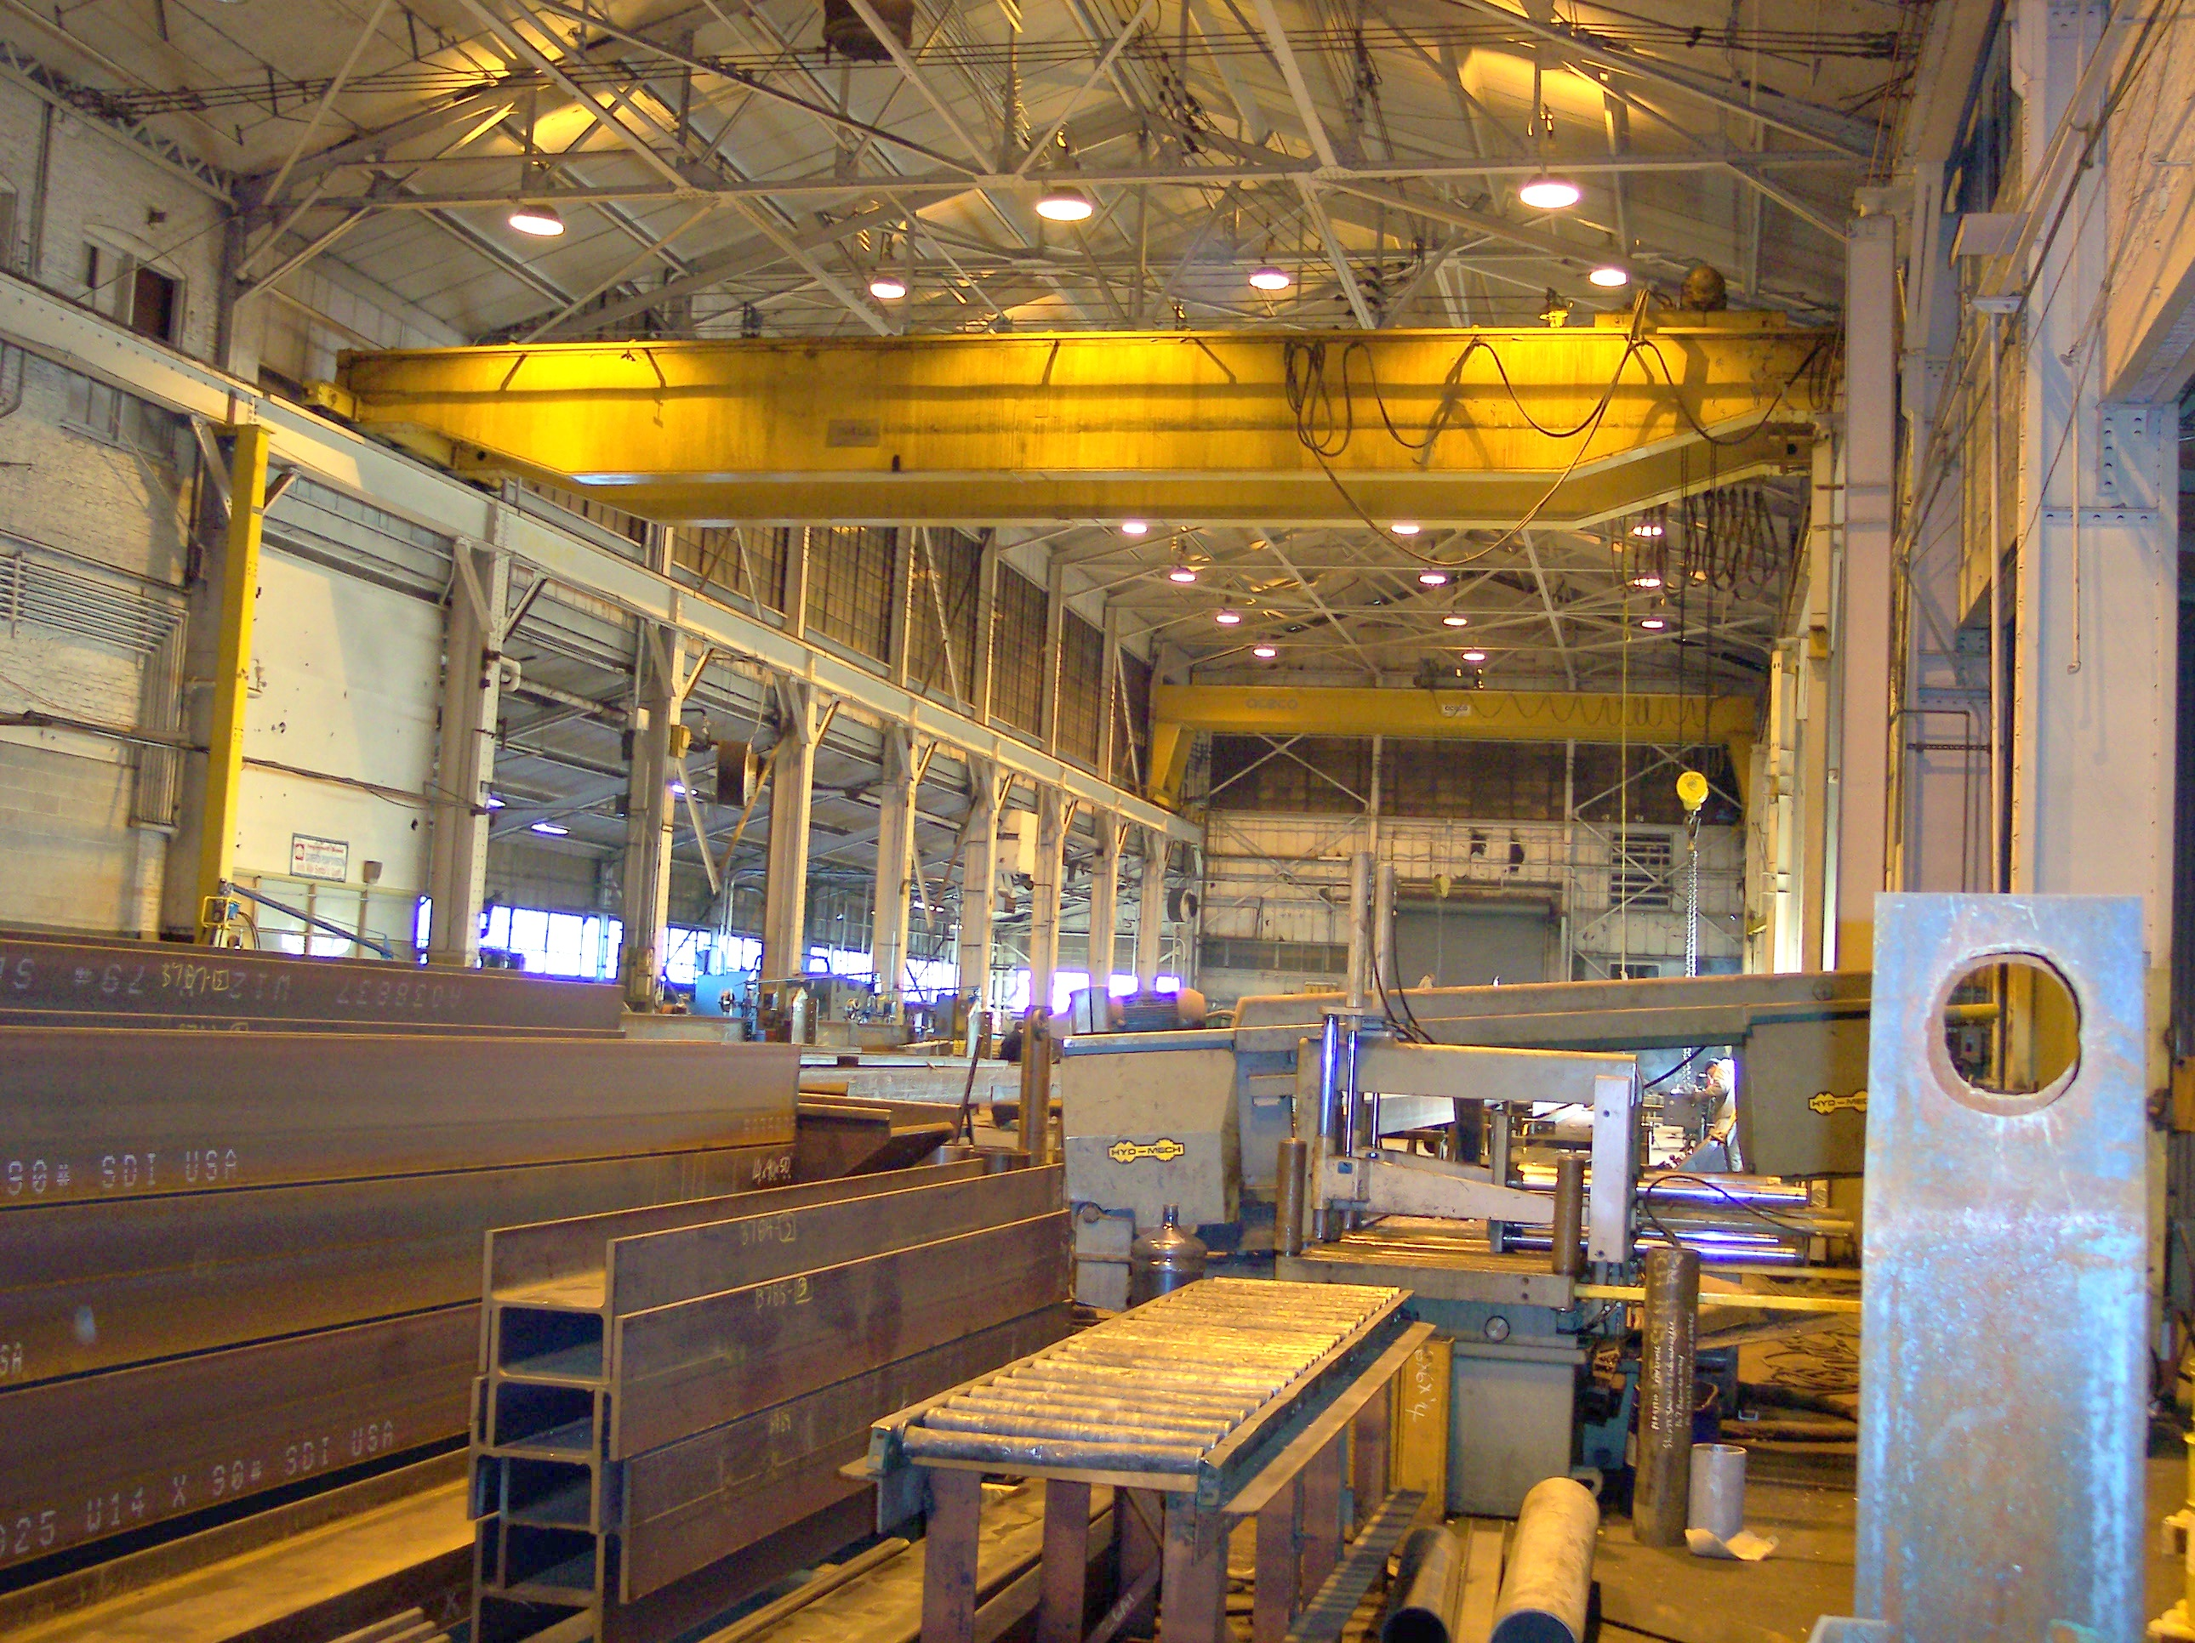


CVI General Resources
Contracting
SKYLINE POWER & ELECTRIC
Utility and Industrial Electrical Services & Equipment
Stateline Fabricators
Skyline Power, LLC, a US firm that designs, procures, installs, supports and maintains Utility and Industrial medium and high voltage electrical projects. Skyline Power utilizes the latest technology and a certified labor force to deliver state-of-the-art cost-effective solutions for our clients.
Stateline Fabricators LLC. 50 acre facility fabricates carbon steel, stainless and aluminum for customer specific work such as building, railing and stair. Additionally, we erected with our own forces.
We have the ability to perform difficult projects and large miscellaneous. metals projects due to our vast knowledge of the industry and with the help of our Engineers and Detailers.
Linares International provide services to both domestic and foreign entities, and we are skilled in connecting counterparts both in the United States and abroad through our one on one personal approach. Our associates decide the degree of privacy that they wish for their entity. Our unique behind the scene low key approach is a benefit for our associates who prefer a more private promotional process of their entity or product.
Global Resources Network specializes in global management and trade. Since 1988 we forged strategic partnerships throughout the world to market products and services, establish distribution channels and design financial programs for our clients.

Slide 3
CVI General Resources
Contracting
SKYLINE POWER & ELECTRIC
Utility and Industrial Electrical Services & Equipment

Slide 4
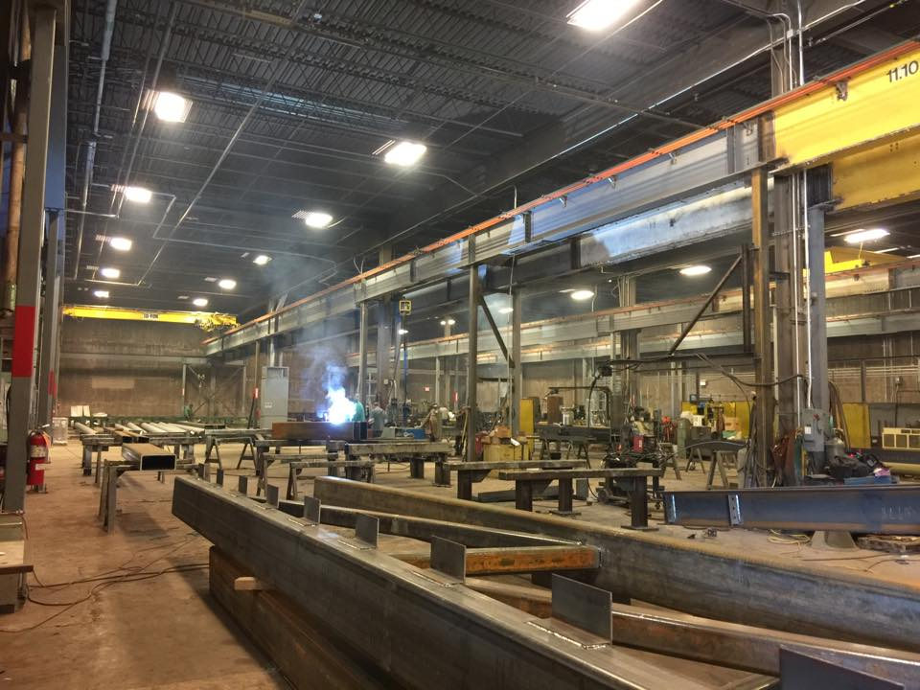
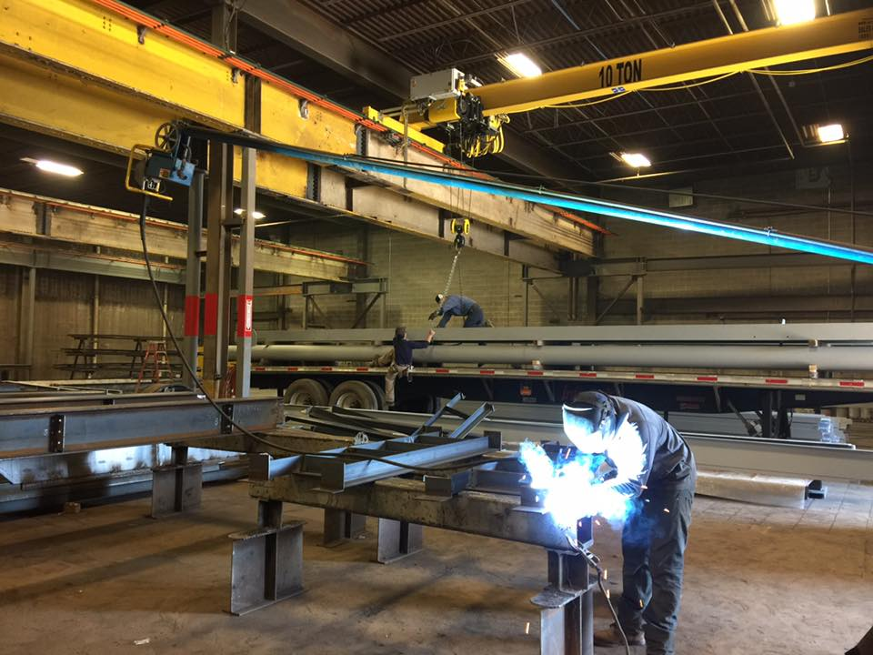
CVI General Resources
Contracting
Stateline Fabricators
Completed Project
PSE&G Sub-Stations Spectra Energy Prudential Tower – Newark
Seton Hall University Garage Merck K15 Marbella South Tower & Garage
Siemens Restack Project Rutgers University Ferring Pharmaceuticals
Target Store - King of Prussia, PA Grainger Warehouse Panasonic - Newark, NJ
Hoboken Train Terminal Bayer Headquarters Nestle Headquarters
Kean University Stamford Hospital Princeton Hospital
"One stop shopping" for all your ironwork needs including carbon steel, stainless and aluminum railings and metal fabrications.

Slide 5
CVI General Resources
Contracting
Projects
Dell Computer & Motorola – establish distribution channels in Central Europe and Russia
I.T.C. of India – formulate go to market strategy in the United States
Iskra of Slovenia – U.S. procurement of computer & telecommunication equipment/ services
MJ Pharmaceutical – Regulator approval with FDA
Global Resources Network, Inc. designs solutions to meet our client’s objectives and goals.
We structure business arrangement with our partners and provide:
Design, Launch, & Manage Distribution Channels Import and Export Services
Agency Agreements Logistics and Insurance
Manufacturers Representations Project Management
Develop Business and Marketing Plans Public and Private Financing
Business Offices (U.S. & International) Trade – Buy/Sell
Licensing Agreements Countertrade/Barter Programs

Slide 6
CVI General Resources
Contracting

